Slide 2
LESSON 4.8
Analyzing Graphs of Polynomial Functions

Slide 3
Today you will:
Use x-intercepts to graph polynomial functions
Use “Location Principle” to identify zeros of polynomial functions
Find “Turning Points” and identify “Local Maximums” and “Local Minimums” of graphs of polynomial functions
Identify “Even Functions” and “Odd Functions”
Practice using English to describe math processes and equations

Slide 4
Core Vocabulary:
Local maximum, p 214
Local minimum, p 214
Even function, p 215
Odd function, p 215
Prior:
End behavior
Increasing
Decreasing
Symmetric about the y-axis

Slide 5
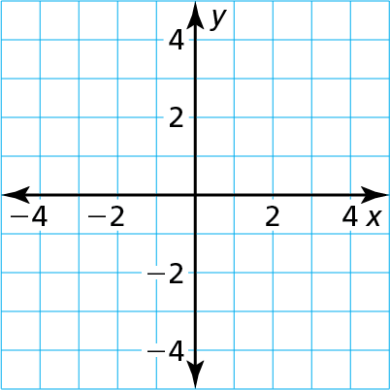
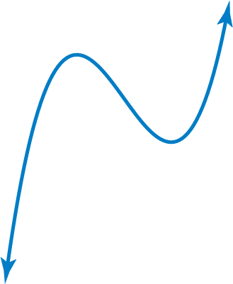
Graph the function
f(x) $=$ $\frac{\text{1}}{\text{6}}$ (x $+$ 3)(x $−$ 2)².
SOLUTION
Step 1 Plot the x-intercepts. Because $−$3 and 2 are zeros
of f, plot ($−$3, 0) and (2, 0).
Step 2 Plot points between and beyond the x-intercepts.
(-3,0)
x | $−$2 | $−$1 | 0 | 1 | 3
y | $\frac{\text{8}}{\text{3}}$ | $$\text{ 3}$$ | 2 | $$\frac{\text{2}}{\text{3}}$$ | 1
(2,0)
Step 3 Determine end behavior. Because f(x) has three factors of the form x $−$ k and
a constant factor of $\frac{\text{1}}{\text{6}}$, f is a cubic function with a positive leading coefficient.
So, f(x) $→$ $−∞$ as x $→$ $−∞$ and f(x) $→$ $+∞$ as x $→$ $+∞$.
Step 4 Draw the graph so that it passes through the plotted points and has the
appropriate end behavior.

Slide 7
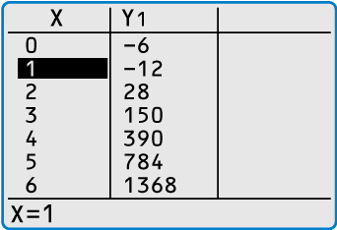
Find all real zeros of
f(x) $=$ 6x³ $+$ 5x² $−$ 17x $−$ 6.
SOLUTION
Step 1 Use a graphing calculator to make a table.
Step 2 Because f is a polynomial function of degree 3, it has 3 zeros.
Use the Location Principle. Find a place where y changes + / -.
From the table shown, you can see that f(1) $<$ 0 and f(2) $>$ 0.
So, by the Location Principle, f has a zero between 1 and 2.
Use the Rational Roots Theorem to find possible roots btwn 1 & 2.
The only possible rational zero between 1 and 2 is $\frac{\text{3}}{\text{2}}$.
Using synthetic division, you can confirm that $\frac{\text{3}}{\text{2}}$ is a zero.
Step 3 Write f(x) in factored form. Dividing f(x) by its known factor x $−$ $\frac{\text{3}}{\text{2}}$ gives a
quotient of 6x² $+$ 14x $+$ 4. So, you can factor f(x) as
f(x) $= \left(\text{x}− \frac{\text{3}}{\text{2}}\right)$(6x² $+$ 14x $+$ 4)
$=\text{2}\left(\text{x}− \frac{\text{3}}{\text{2}}\right)$(3x² $+$ 7x $+$ 2)
$=\text{2}\left(\text{x}− \frac{\text{3}}{\text{2}}\right)$(3x $+$ 1)(x $+$ 2).

Slide 8
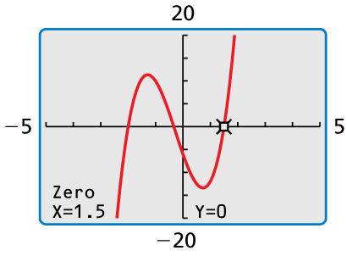
$=\text{2}\left(\text{x}− \frac{\text{3}}{\text{2}}\right)$(3x $+$ 1)(x $+$ 2).
Check
From the factorization, there are three zeros. The zeros of f are
$\frac{\text{3}}{\text{2}}$, $−\frac{\text{1}}{\text{3}}$, and $−$2.
Check this by graphing f.

Slide 11
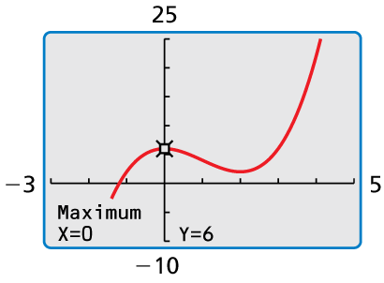
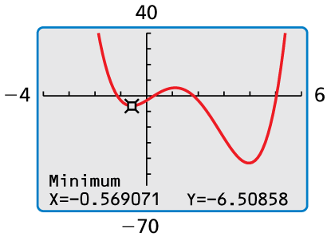
Graph each function. Identify the x-intercepts and the points where the local
maximums and local minimums occur. Determine the intervals for which each
function is increasing or decreasing.
a. f(x) $=$ x³ $−$ 3x² $+$ 6
b. g(x) $=$ x⁴ $−$ 6x³ $+$ 3x² $+$ 10x $−$ 3
SOLUTION
Use a graphing calculator to graph the function.
The graph of f has one x-intercept and two turning points.
Use the graphing calculator’s zero, maximum, and minimum features to
approximate the coordinates of the points.
The x-intercept of the graph is x $≈$ $−$1.20. The function has a local maximum
at (0, 6) and a local minimum at (2, 2). The function is increasing when
x $<$ 0 and x $>$ 2 and decreasing when 0 $<$ x $<$ 2.
b. Use a graphing calculator to graph the function. The graph of g has four
x-intercepts and three turning points. Use the graphing calculator’s zero, maximum,
and minimum features to approximate the coordinates of the points.
The x-intercepts of the graph are x $≈$ $−$1.14, x $≈$ 0.29, x $≈$ 1.82, and
x $≈$ 5.03. The function has a local maximum at (1.11, 5.11) and local
minimums at ($−$0.57, $−$6.51) and (3.96, $−$43.04). The function is increasing
when $−$0.57 $<$ x $<$ 1.11 and x $>$ 3.96 and decreasing when x$<$ $−$0.57 and
1.11 $<$ x $<$ 3.96.

Slide 12
IMPORTANT NOTE:
This is NOT
…repeat NOT…
…(did I say NOT?)…
…NOT NOT NOT…
the same as even degree
or odd degree
This is about SYMMETRY

Slide 13
Determine whether each function is even, odd, or neither.
a. f(x) $=$ x³ $−$ 7x
b. g(x) $=$ x⁴ $+$ x² $−$ 1
c. h(x) $=$ x³ $+$ 2
SOLUTION
a. Replace x with $−$x in the equation for f, and then simplify.
How to do this:
Find $f\left(−x\right)$
Find $−f\left(x\right)$
Compare $f\left(x\right)$, $f\left(−x\right)$, & $−f\left(x\right)$
f($−$x) $=$ ($−$x)³ $−$ 7($−$x) $=$ $−$x³ $+$ 7x $=$ $−$(x³ $−$ 7x) $=$ $−$f(x)
Because f($−$x) $=$ $−$f(x), the function is odd.
b. Replace x with $−$x in the equation for g, and then simplify.
g($−$x) $=$ ($−$x)⁴ $+$ ($−$x)² $−$ 1 $=$ x⁴ $+$ x² $−$ 1 $=$ g(x)
Because g($−$x) $=$ g(x), the function is even.
c. Replacing x with $−$x in the equation for h produces
h($−$x) $=$ ($−$x)³ $+$ 2 $=$ $−$x³ $+$ 2.
Because h(x) $=$ x³ $+$ 2 and $−$h(x) $=$ $−$x³ $−$ 2, you can conclude that
h($−$x) $≠$ h(x) and h($−$x) $≠$ $−$h(x). So, the function is neither even nor odd.

Slide 14
Homework
Pg 216, #3-45 odd

